Slide 1
COM3(0)37 Computer Graphics
Practical Demo 4
Interaction

Slide 2
Interaction
OpenGL and WebGL do not support interaction directly for portability reasons
For OpenGL to work in different environments, window and input functions are not included in the API
For desktop OpenGL, you need to use extra libraries such as GLUT (inter-platform), GLW (windows), GLX (x server), …
For WebGL, we will make use of the facilities of HTML, browser, and Javascript.

Slide 3
Input Devices
2 ways to think about input devices:
As physical devices, or
As logical devices
what they do from the program’s perspective
Consider
int x;
cin >> x;
cout << x;
x gets its value from keyboard
Physical or on-screen?
Then it is displayed on screen
But, we could arrange it to be output to a file
Using cin and cout doesn’t require us to know anything about the actual physical devices

Slide 4
Input Devices
Functions like printf in C or cout in C++ actually represent a logical view of the output (or the input)
For graphical input devices (e.g. a mouse), there are more options
For example, you can use it to
select a screen location, or
choose a menu item.
These correspond to different logical functions
an (x,y) coordinate to the program,
the identifier of the chosen menu item
By separating physical and logical view, a device can be replaced without any modification
E.g., same program can work with a mouse, a touch screen, or a trackball

Slide 5
Input Events
When an input device is triggered, an event is generated
Information about the event (device identifier, etc.) is placed in an event queue
When writing applications, we use callback functions
These are functions to be called when a certain event happens
Event categories:
Mouse events (moving the mouse and pressing or releasing buttons)
Window events (opening, closing, resizing, minimizing)
Keyboard events (pressing or releasing keys)
OS or browser events (idle, load)

Slide 6
Programming Event-Driven Input
Let’s develop examples using callback functions
We will see various events recognized by WebGL through HTML5
WebGL does not include anything for input
we use Javascript and HTML for the interaction
An event has a type (e.g., click) and a target (a specific button, mouse)
Each event has a name recognized by Javascript (these names also appear as functions that start with on-, such as onload and onclick)

Slide 7
Programming Event-Driven Input
In our examples, we used a load event callback
window.onload = function init() { … }
The callback functions that we associate with events are also called event listeners or event handlers

Slide 8
Adding a Button
A button will change the direction of rotation for the rotating square program
First, add a button to the web page with the following HTML code
<button id = "DirectionButton">
Change Rotation Direction
</button>
In the script, we introduce a variable to represent the current direction of rotation
var direction = true;
And we update the theta according to this value
theta += (direction ? 0.1 : -0.1);

Slide 9
Adding a Button
Finally, we need to connect with the button and add an event listener with
var myButton = document.getElementById("DirectionButton");
myButton.addEventListener("click",
function() {direction = !direction;});
or alternatively with
document.getElementById("DirectionButton").onclick =
function() { direction = !direction; };
or with “mousedown” instead of “click” in either case

Slide 10
Adding a Button
Clicking any button will work with the previous program because we didn’t specify a button
If we only want left click, we can write
myButton.addEventListener("click", function() {
if (event.button == 0) {
direction = !direction;
}
});
For a 3 button mouse, 0 is left, 1 is middle, and 2 is right button.

Slide 11
Try on your own! - Menus
Menus are specified by select elements in HTML
Each menu entry has text and an associated number (that we will use in the application)
<select id="mymenu" size="3">
<option value="0">
Toggle Rotation Direction X
</option>
<option value="1">Spin Faster</option>
<option value="2">Spin Slower</option>
</select>

Slide 12
Try on your own! - Menus
Again, we connect with the menu as an HTML element and write our callback function
var m = document.getElementById("mymenu");
m.addEventListener("click", function() {
switch (m.selectedIndex) {
case 0:
direction = !direction;
break;
case 1:
delay /= 2.0;
break;
case 2:
delay *= 2.0;
break;
}
});

Slide 13
Try on your own! - Using Keycodes
window.addEventListener("keydown”,
function() {
switch (event.keyCode) {
case 49: // ’1’ key
direction = !direction;
break;
case 50: // ’2’ key
delay /= 2.0;
break;
case 51: // ’3’ key
delay *= 2.0;
break;
}
});
window.onkeydown =
function(event) {
var key = String.fromCharCode(event.keyCode);
switch (key) {
case ’1’:
direction = !direction;
break;
case ’2’:
delay /= 2.0;
break;
case ’3’:
delay *= 2.0;
break;
}
};

Slide 14

Try on your own! - Sliders
A slider element is a useful GUI element
To create a slider in HTML to set the delay between 0 and 100 ms
<div>
speed 0 <input id="slide" type="range"
min="0" max="100" step="10" value="50" />
100 </div>
To get the value of the slider in the script
document.getElementById("slide").onchange = function() {delay = this.value;};

Slide 15
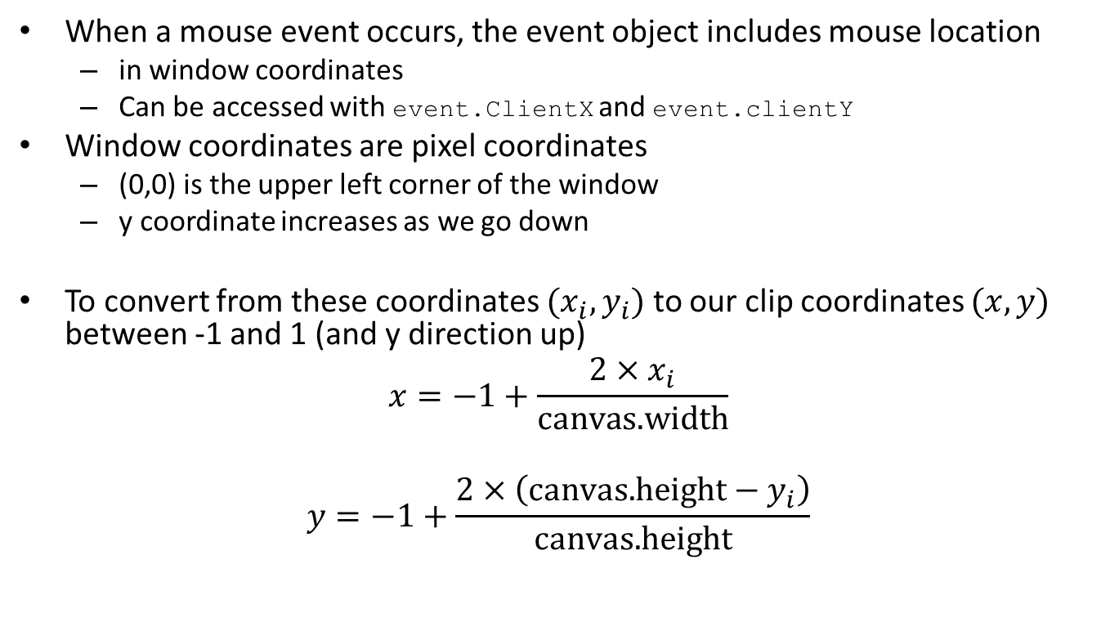
Position Input
When a mouse event occurs, the event object includes mouse location
in window coordinates
Can be accessed with event.ClientX and event.clientY
Window coordinates are pixel coordinates
(0,0) is the upper left corner of the window
y coordinate increases as we go down
To convert from these coordinates $(x_{i},y_{i})$ to our clip coordinates $(x,y)$ between -1 and 1 (and y direction up)
$$x=−1+\frac{2×x_{i}}{\text{canvas}\text{.}\text{width}}$$
$$y=−1+\frac{2×\left(\text{canvas}\text{.}\text{height}−y_{i}\right)}{\text{canvas}\text{.}\text{height}}$$

Slide 16
Position Input
canvas.addEventListener("click", function(event) {
gl.bindBuffer(gl.ARRAY_BUFFER, bufferId);
var t = vec2(-1 + 2*event.clientX/canvas.width,
-1 + 2*(canvas.height-event.clientY)/canvas.height);
gl.bufferSubData(gl.ARRAY_BUFFER,
sizeof['vec2']*index,
flatten(t));
index++;
});
What does the above code do?

Slide 17
Window Events
Resizing, minimizing, restoring are examples of window events
If window is resized, program can decide what to do
3 questions in this case:
Do we draw all objects that were on the canvas before resizing?
What if aspect ratio has changed?
Do we change the size or attributes of new primitives?

Slide 18
Window Events
There is no single correct answer to these questions
We generally answer depending on the application and how we want the output to be after resizing

Slide 19
Selecting a Primitive
How can we do it
in 2D?
in 3D?

Slide 20
Selecting a Primitive
Can do it with
Geometry
Intersection calculations
(Axis-aligned) bounding boxes, or extents
A trick with drawing on an extra color buffer and
using gl.readPixels function

